Slide 1
TIL6010 TIL Programming | Python
Wouter Schakel
3 September 2021

Slide 2
Recap Week 1

Slide 3








Recap week 1
Programming environment

Slide 4
Recap week 1
Done so far
Created a local Jupyter Notebook
Installed libraries (pandas, git, …)
Created a personal repository on GitHub
Committed local files to GitHub repository
Watched repository “Panchamy/TIL6010” or cloned it to local computer
Brightspace → Week 1 Fundamentals → Guide of 1st lab session

Slide 5
Data structures in Python

Slide 6

Primitive built-in types
What are they?
Basic data elements
Types:
integer 1, 3, -8, 1027, 645073 int()
float 1.5, 3.456, -843.233 float()
string any text str()
bool ean True, False bool()

Slide 7

Primitive built-in types
Integer quiz
A: 0
1
-1
B: 0
0
-1
C: 1
1
0
D: 0
0
0
E: 1
1
-1
F:
Error

Slide 8
Primitive built-in types
String quiz
A: 7
B: 43

Slide 9

Primitive built-in types
Boolean quiz
A: True
True
B: False
True
C: True
False
D: False
False

Slide 10

Primitive built-in types
Boolean quiz
A: yes
B: no

Slide 11
Built-in data structures
Arrays
There are no arrays in the Python core
Lists can be used as arrays
What are they?
Any groupings of primitives or other objects
Type | Duplicate values | Mutable | Method | Initialization
Tuple | Yes | No | tuple() | (a, b)
List | Yes | Yes | list() | [a, b]
Set | No | Yes | set() | {a, b}
Frozenset | No | No | frozenset() | N/A

Slide 12
Built-in data structures
Indexed vs. hash structure
Tuple & List are indexed
Retrieve & insert items at specific indices
Order is fixed, also when iterating
Set & FrozenSet have underlying hash structures
Much faster when looking up items
No specific order when iterating
Order can change after removing, replacing or adding items (Set only)
Hashing
Objects provide a hashcode (integer)
Hash structure relates hashcode to buckets with only few items

Slide 13
Built-in data structures
Methods
Methods tuple(), list(), set() and frozenset() accept any iterable
Iterables can give one element at a time
All these data types are iterable
They can be converted
More on iterables in week 4

Slide 14
Built-in data structures
Ranges
Primarily used in for-loops
In many ways equal to a list
Only contains the current value for iteration in memory
Only accepts int’s
Uses a step size

Slide 15

Built-in data structures
Range question
A: 6
5
4
3
2
B: 5
4
3
2
C: 6
5
4
3
D: 6
4
2
0
E: 4
2
0
F: 6
4
2
G:
(empty)
H:
Error

Slide 16
Built-in data structures
Dictionaries
Contains key-value pairs
Maps each key to a value
Keys are unique
Mutable
Method dict(), with many different possibilities
Initialization: { key: value, … }

Slide 17
Built-in data structures
Classes
A class groups properties and methods
Classes can extent each other
The subclass extents the superclass with additional properties and methods
More on classes in week 4

Slide 18
Built-in data structures
Notes on data types
Python has implicit type conversion
a = 1 (int) a = 1.0 (float) a = ‘1.0’ (string)
Data structures can be elements (including dictionary keys)
set_of_list_and_Person = { [1, 2, 3], Person(‘jane’) }
It is up to the programmer to be consistent with types, and units of numeric values! → Use proper commenting/documenting

Slide 19
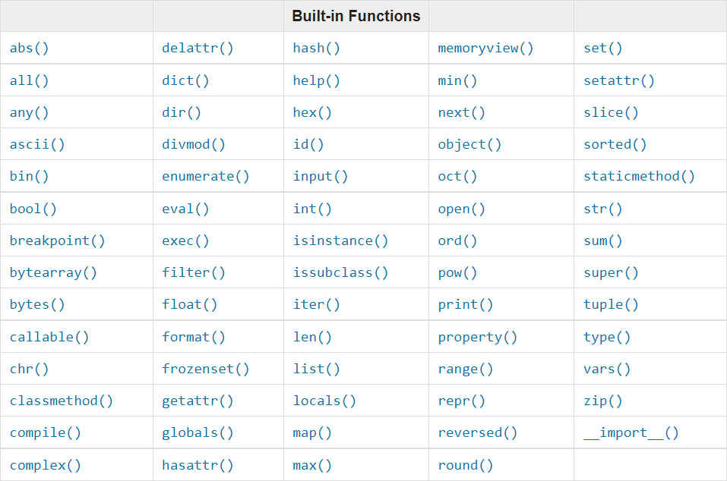
Built-in methods
https://docs.python.org/3.9/library/functions.html

Slide 20
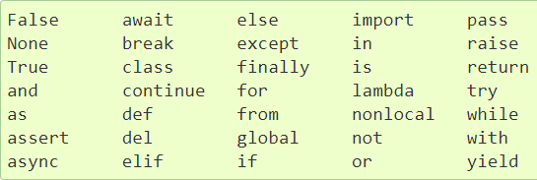
Python keywords
Variable and method can not have these names
https://docs.python.org/3/reference/lexical_analysis.html#keywords

Slide 21
Python operators
Arithmetic: +, -, *, /, **, …
Assignment: =, +=, *=, …
Comparison: ==, !=, >, <=, …
And more:
https://www.w3schools.com/python/python_operators.asp

Slide 22
OS Library

Slide 23
OS Library
Directories
Files
Low-level file reading and writing
For common file types, libraries exist (e.g. pandas)
Environment variables
And more…

Slide 24
Lab session next Thursday

Slide 25
Lab session
Preparation
Read up on Python, suggestions:
Set methods https://www.programiz.com/python-programming/set
Built-in methods https://docs.python.org/3.9/library/functions.html
Keywords https://docs.python.org/3/reference/lexical_analysis.html#keywords
Operators https://www.w3schools.com/python/python_operators.asp

Slide 26
Lab session
Preparation
Assignments
Not mandatory
Will be made available over the weekend or Monday

